Slide 1
Final Product
Process
ResearchGenAI & CodeCrusaders

Slide 2


01
How it all started

Slide 3
Quick reminder
ResearchGenAI - Yakov and Lia, presented a paper about biases in LLM models such as Codex and GPT3.
A few terms from the paper:
Framing Effect - Models generate solutions based on irrelevant prompt information.
Anchoring - the tendency to rely heavily on the first piece of information encountered.

Slide 4
Quick reminder
Research Approach
•Construct prompt transformations inspired by cognitive biases
•Measure accuracy and error types in code generation models

Slide 5

Another Quick reminder
CodeCrusaders presented a paper about the performance and feasibility of Large Language Models (LLMs) specialized for code generation, such as Codex, focusing on their ability to generate Python functions from docstrings and comparing their performance to general-purpose LLMs like GPT-3.
The study uses functional correctness metrics and human-written evaluation sets to compare the performance of Codex, GPT-3, and GPT-J in generating Python code from docstrings, finding that fine-tuning Codex on code data from GitHub improves performance but still lags behind human capabilities.

Slide 6
What's in common?
Both articles focus on Large Language Models: Both papers deal with large language models (LLMs) and their evaluation, although the contexts differ—one focusing on human cognitive biases and the other on code generation.
Emphasis on Correctness: Both works stress the importance of correct outputs. The first paper examines incorrect model outputs influenced by cognitive biases, and the second looks at the correctness of generated code.

Slide 7
What are we trying to figure out?
To what extent does a custom GPT model enhance the accuracy, functionality, and bias reduction of AI-generated outputs when compared by existing AI tools, using prompts refined by the custom model and evaluated against the HumanEval dataset?

Slide 8
02
Usage of HumanEval Dataset
(AI)

Slide 9
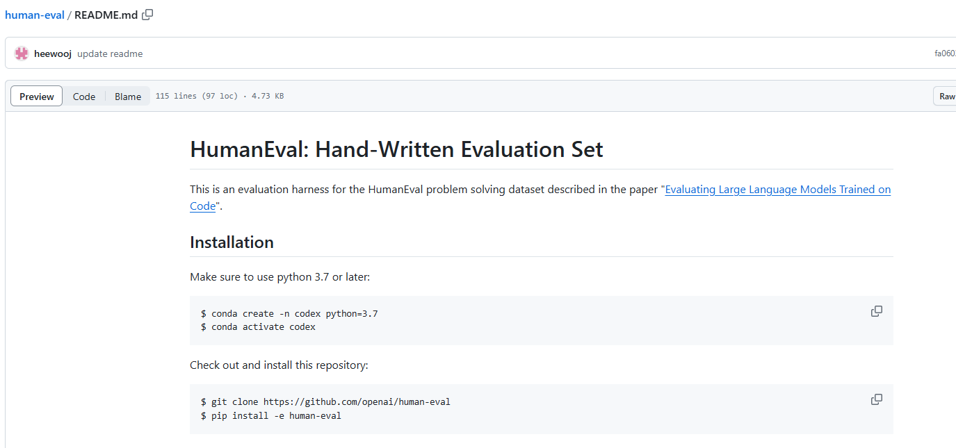
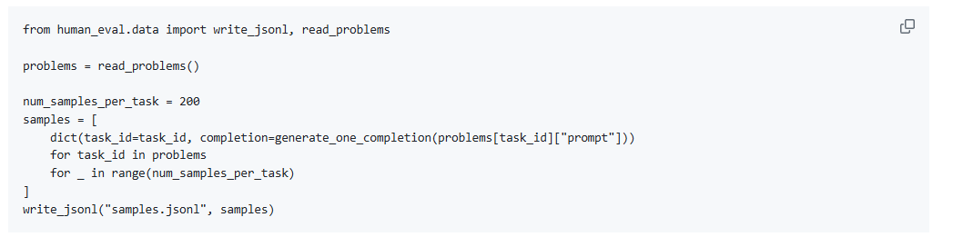
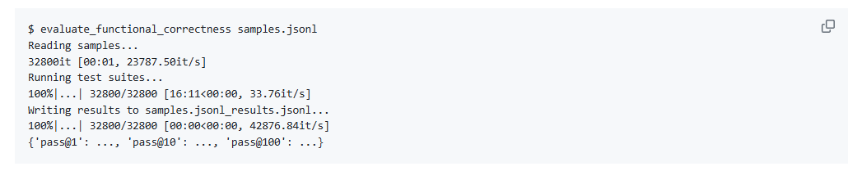

Slide 10
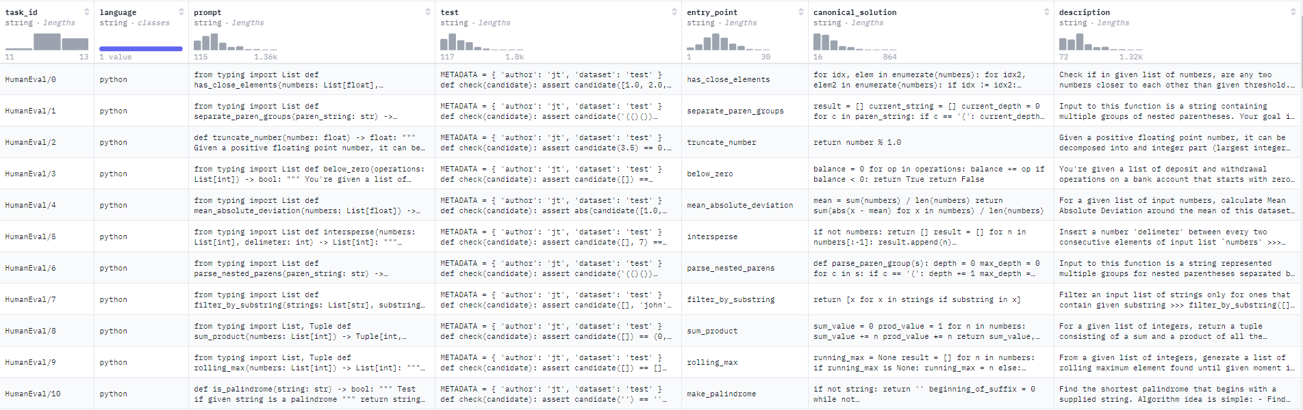
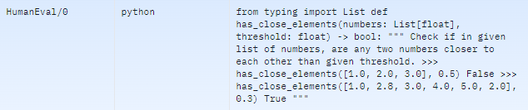
HumanEval Dataset by OpenAI

Slide 11
03
Usage of JavaGPT to run API
(AI)

Slide 12
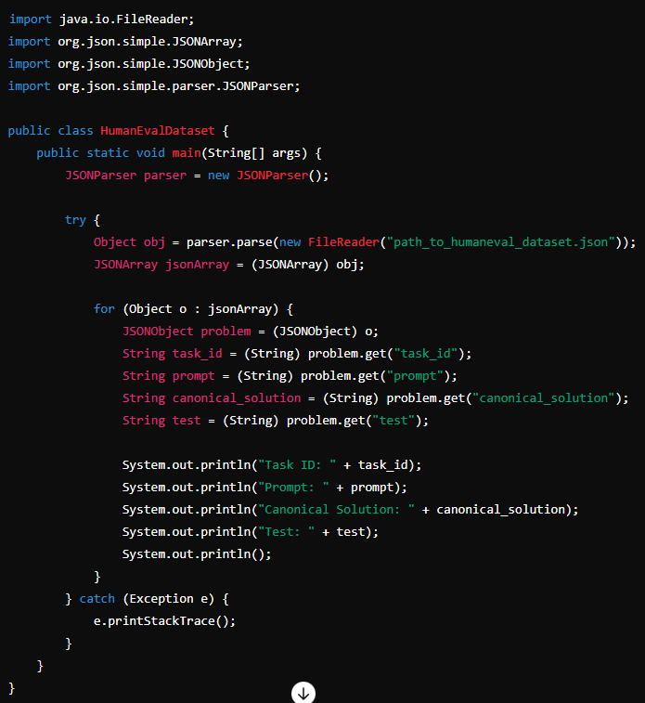
From Python to Java
A Java GUI that interfaces ChatGPT API:
Chat streaming
Saving and loading previous chats
Understanding Syntax differences: Python and Java have different syntax rules. Python is dynamically typed, while Java is statically typed, meaning you need to explicitly define variable types in Java.
Parsing the dataset in Java: Using the appropriate libraries to read and parse the dataset
Downloading the Dataset: Download the HumanEval dataset from GitHub.

Slide 13
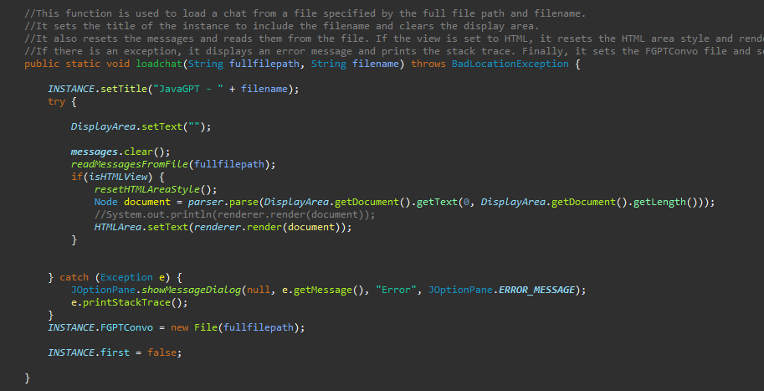
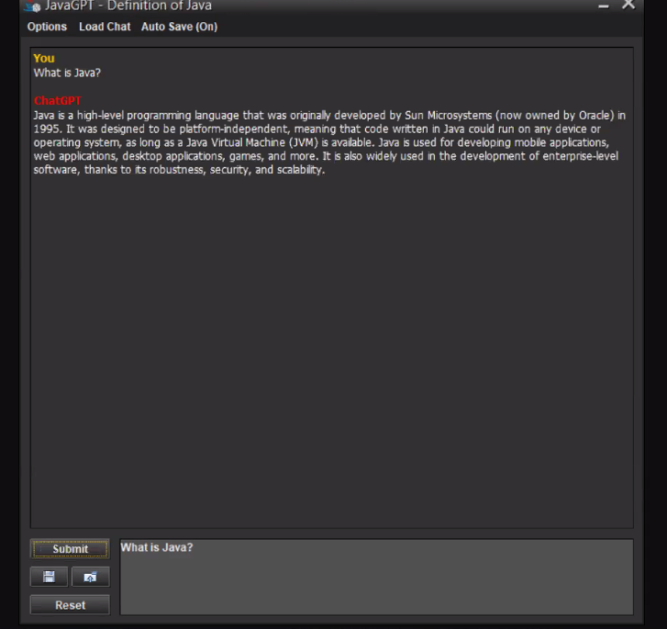
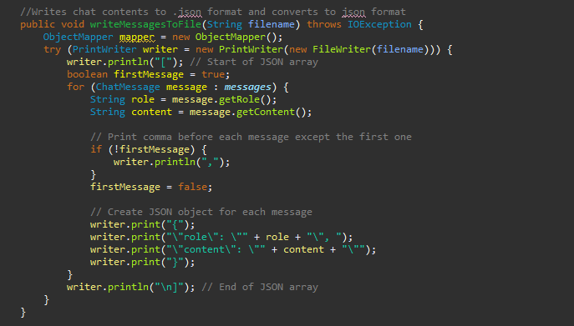

Slide 14
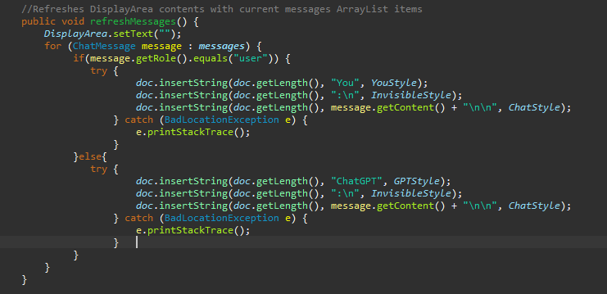
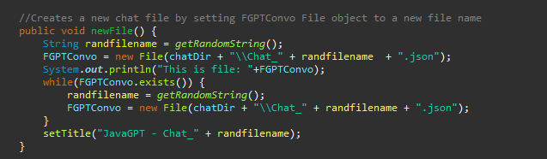

Slide 15
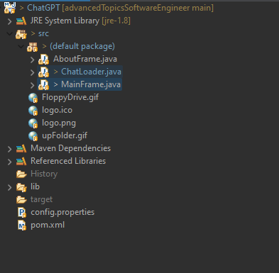
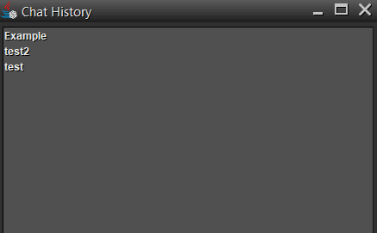
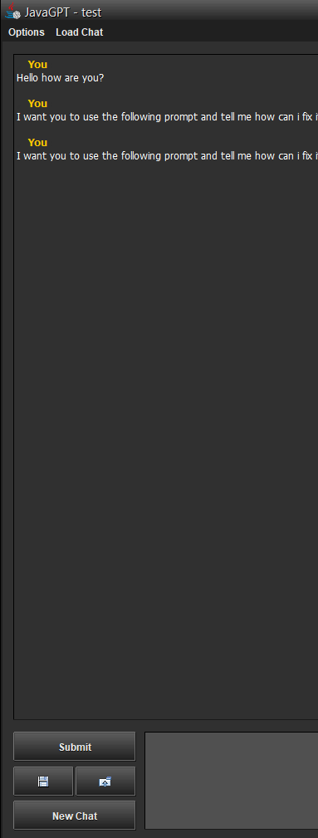

(+) Usage of the chat history to track user’s former inputs and upload prompts.
(+) A View of the Interface of the program

Slide 16
04
Incorporating the LLM model into the customized JavaGPT tool
(AI)

Slide 17
A Disadvantage of Custom LLMS
(-) Developing them can be expensive
The cost is high. In order to create the model and compare with existing models for specific purpose (in our case, prompt improvement and bias comparison) and do it for long term research, it is essential to some amount of money that can cover the necessary development and maintenance costs of these tools.

Slide 18
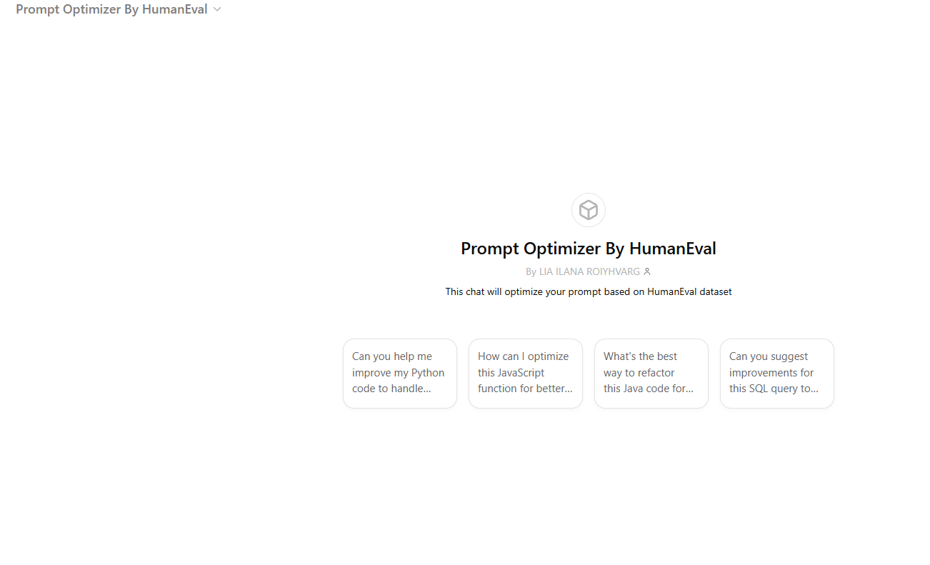
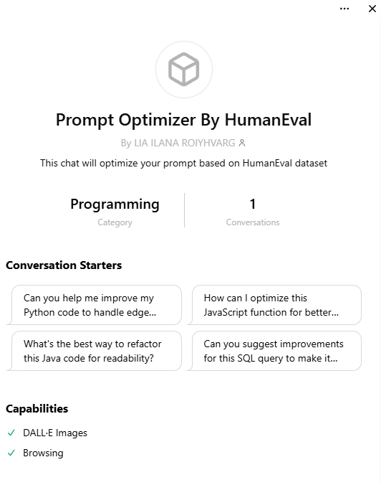

Slide 19
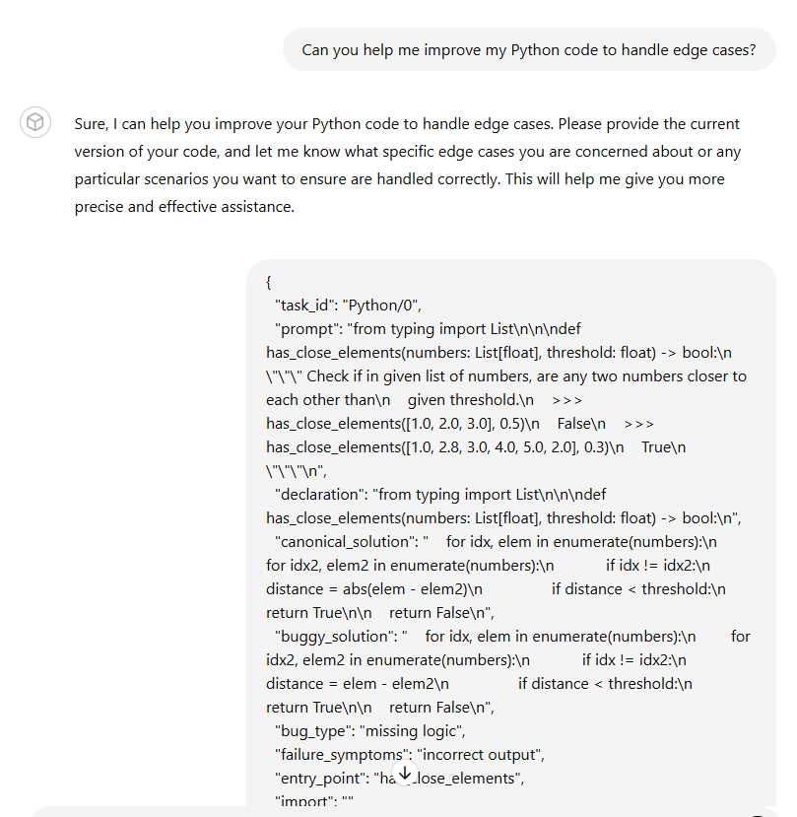
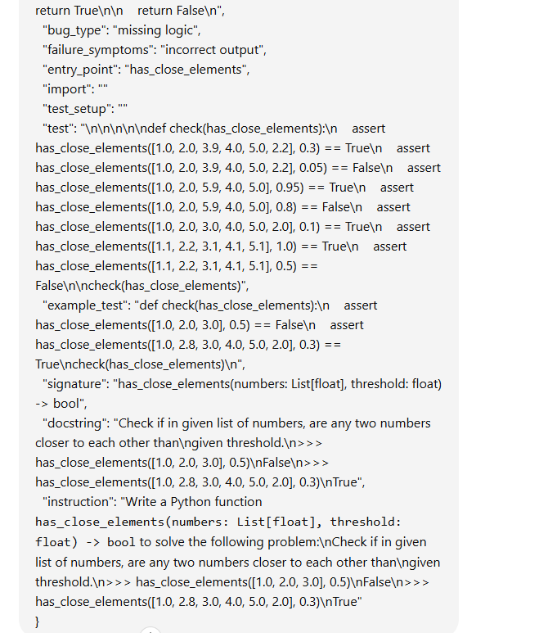
Testing the Model

Slide 20
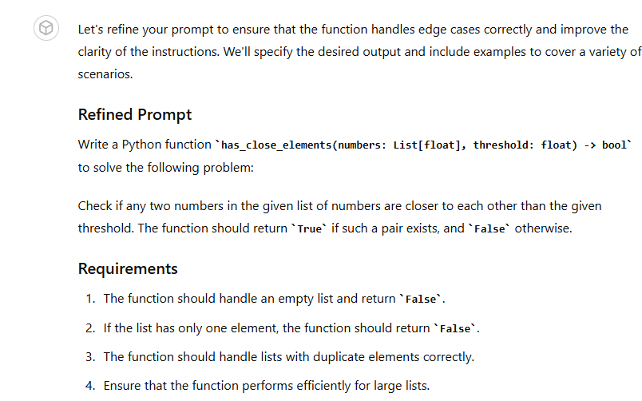
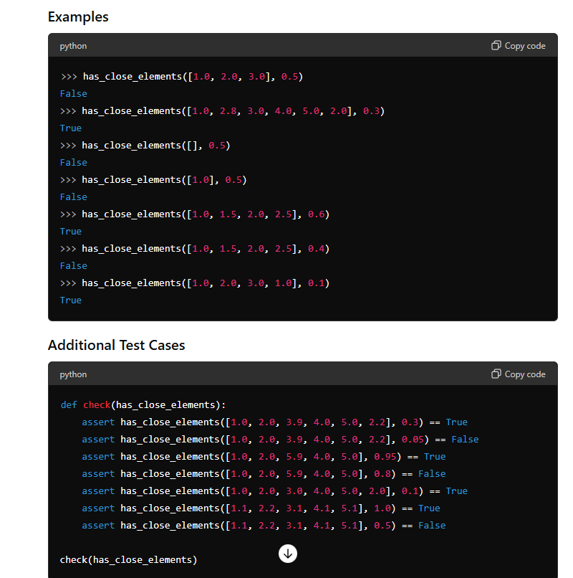
Testing the Model

Slide 21
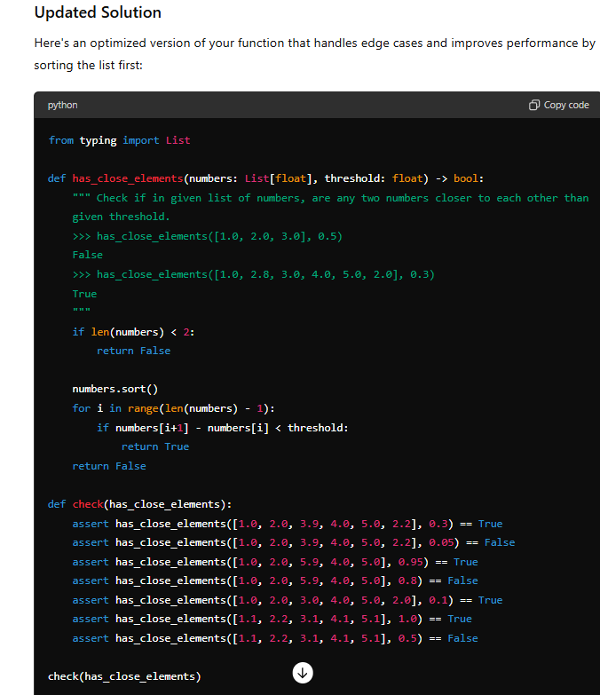
Testing the Model

Slide 22
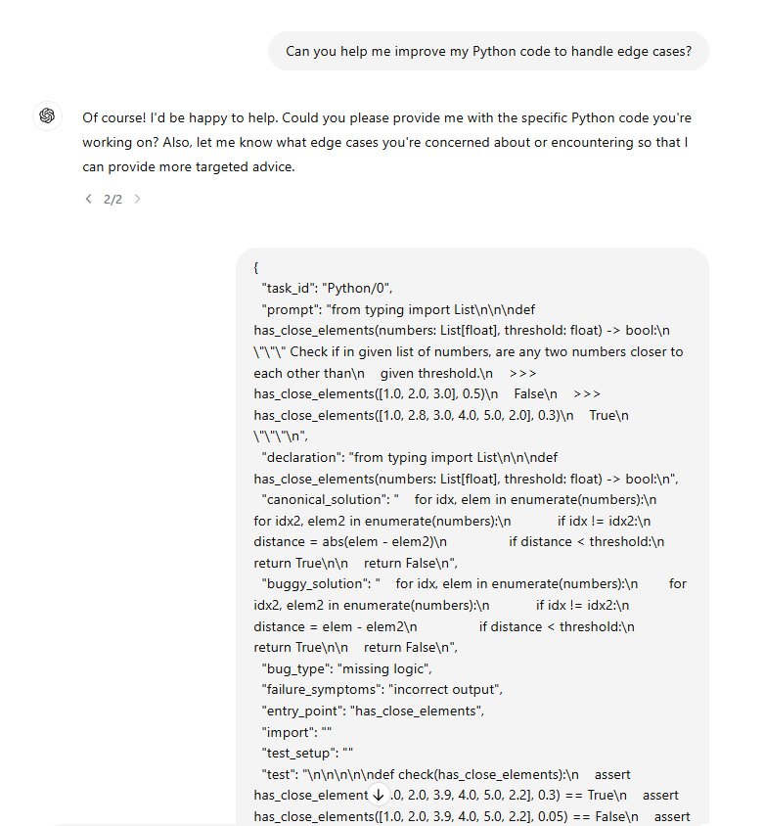
Comparing between Copilot, Gemini and GPT 3.5

Slide 23
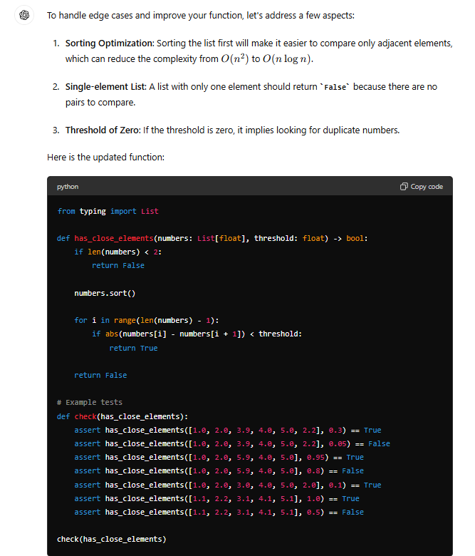
Comparing between Copilot, Gemini and GPT 3.5
GPT 3.5 -> <- Custom HumanEval Prompt enhanced GPT

Slide 24
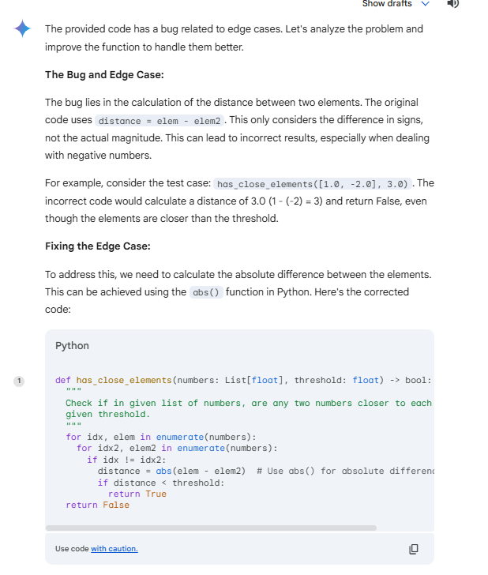
Comparing between Copilot, Gemini and GPT 3.5
Gemini -> <- Custom HumanEval Prompt enhanced GPT

Slide 25
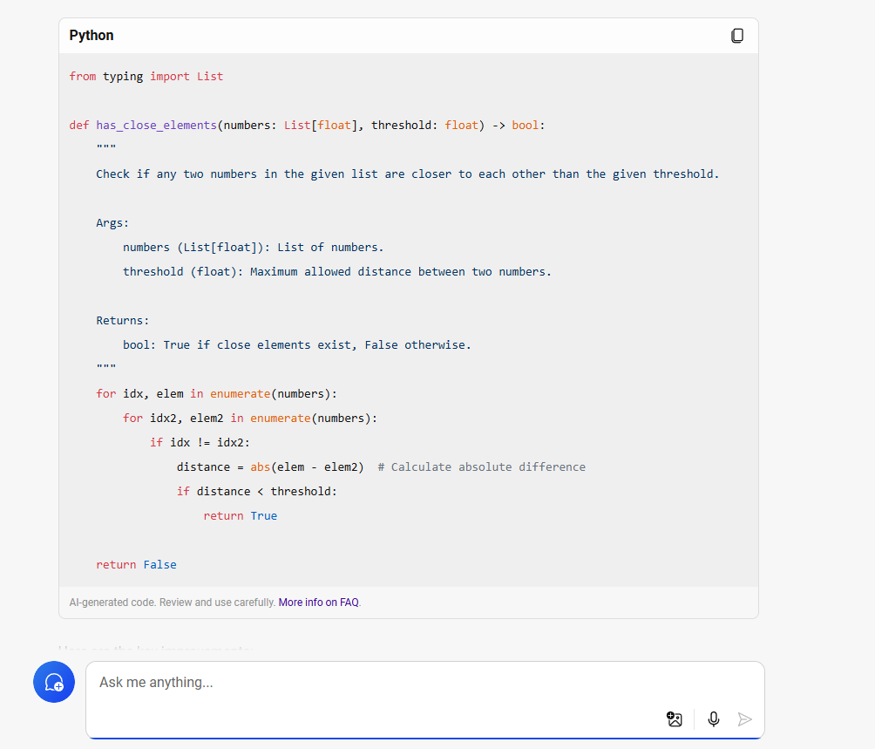
Comparing between Copilot, Gemini and GPT 3.5
Copilot -> <- Custom HumanEval Prompt enhanced GPT

Slide 26
Whats next?

Slide 27
Thanks!

